Slide 1
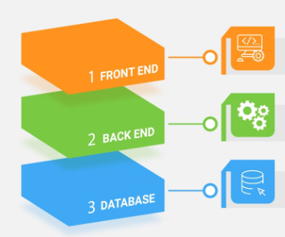
Full Stack Development

Slide 2
Full Stack Web Development
It is the process of creating both the front end and the back end of a web application.
The front end is the part that the user sees and interacts with, while the back end is the part that handles the data storage and processing.
Full stack web developers need to master various skills and technologies, such as HTML, CSS, JavaScript, Bootstrap, Python, SQL, DB, RESTful routes, etc.

Slide 3

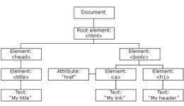
Front-End Development with ReactJS
ReactJS is a JS library for building UI's. It provides a component-based approach to web development, where each component represents a piece of the UI.
Key features of ReactJS:
- Component-based architecture
- Virtual DOM for improved performance
- Efficient event handling and state management
- Reusable code components
- Large community for support and resources

Slide 4

Back-End Development with Spring Boot
Spring Boot is a framework for building Java-based web applications.
Database used: PostgreSQL
Key features of Spring Boot:
- Easy configuration and setup
- Powerful dependency injection
- Wide range of data sources support
- Integration with other frameworks and libraries

Slide 5
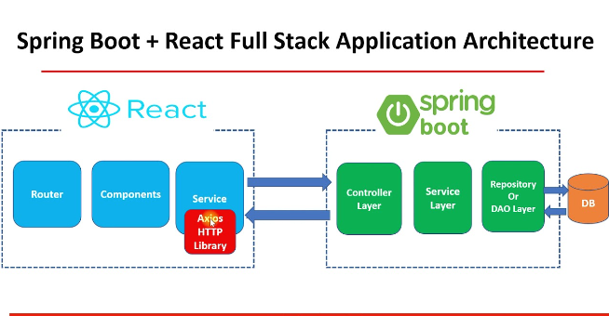
Full Stack Web Development with ReactJS and Spring Boot
Can be used together to create a comprehensive Full Stack solution and can deliver a seamless user experience.
Benefits :
- Efficient development process
- Robust and scalable solution
- large community support
- Extensive libraries and frameworks support
- Easy integration with various data sources

Slide 6
APARTMENT SECURITY MANAGEMENT SYSTEM
APP DEMO

Slide 7


Slide 8
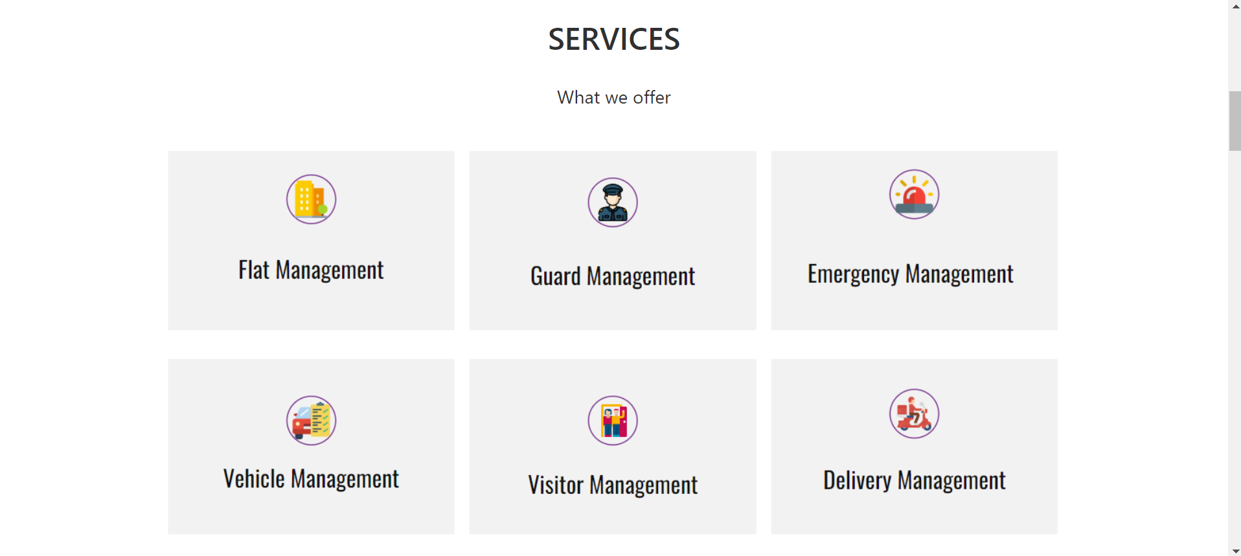

Slide 9
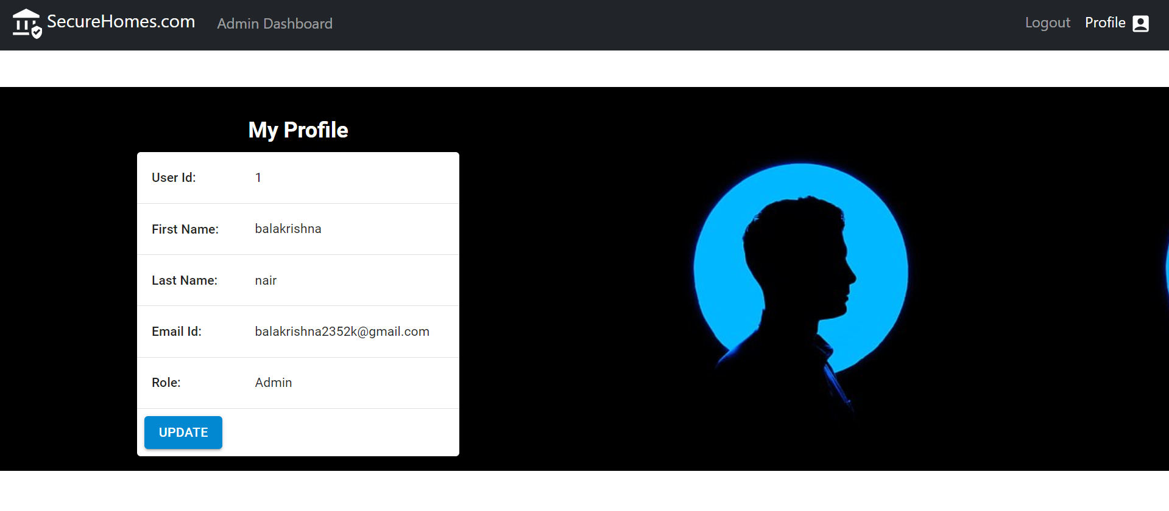

Slide 10
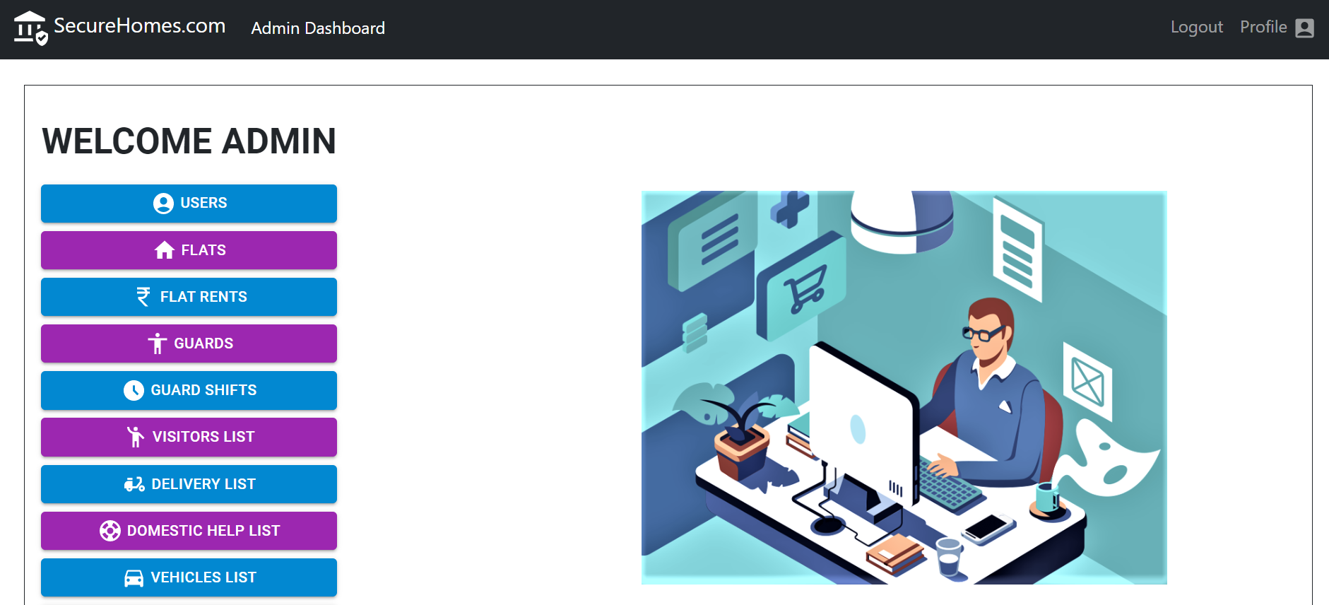

Slide 11

THANK YOU

